Slide 1


Development of a catalog of federated SPARQL queries in the field of Rare Diseases
Marc Hanauer marc.hanauer@inserm.fr

Slide 2
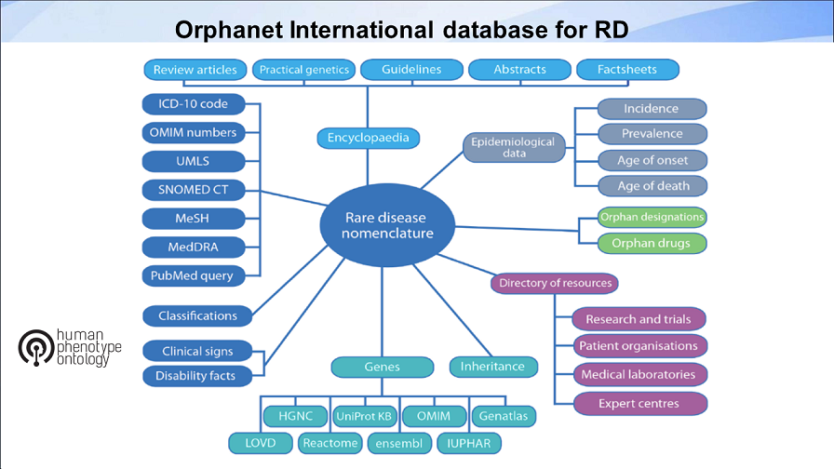


Background information - Context of the project
BioHackathon Paris – 12/16 Nov 2018
Notes:
Diapo de Charlotte: frise 20 ans

Slide 3
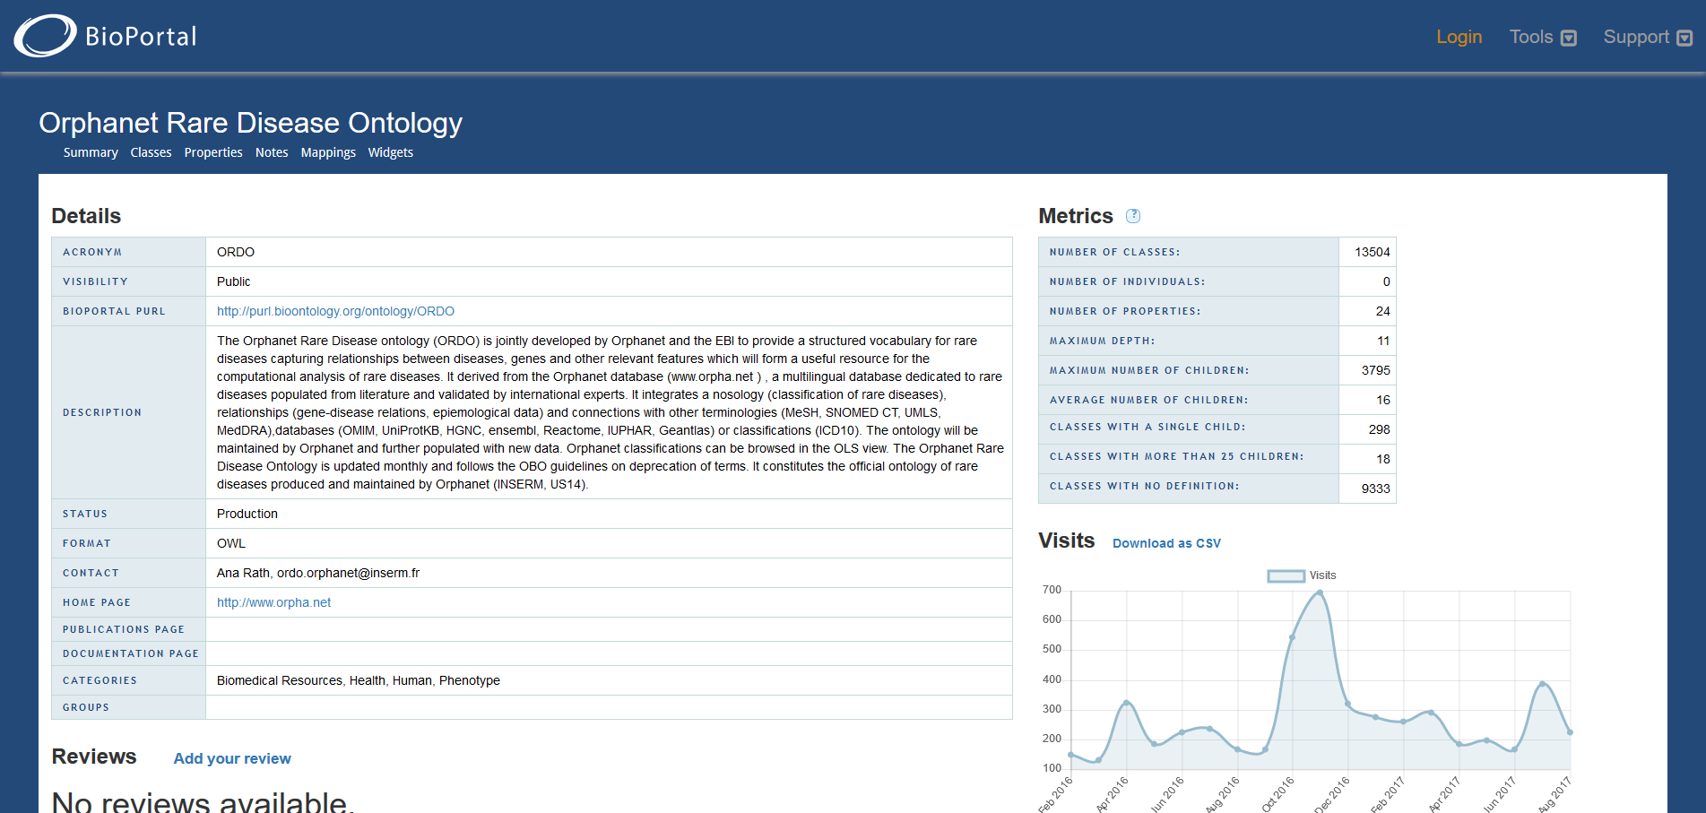
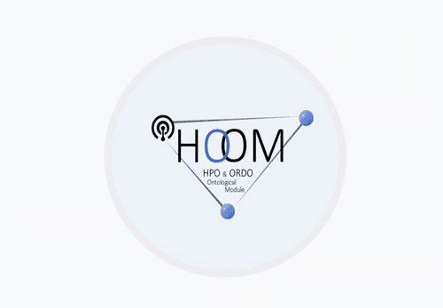
Background information - Context of the project
BioHackathon Paris – 12/16 Nov 2018
Notes:
Diapo de Charlotte: frise 20 ans

Slide 4
Background information - Context of the project
Orphanet
SPARQL
Reactome
SPARQL
wikipathway
SPARQL
Uniprot
SPARQL
wikidata
SPARQL
EBI
SPARQL
Disgenet
SPARQL
Any relevant
SPARQL
BioHackathon Paris – 12/16 Nov 2018
Notes:
Diapo de Charlotte: frise 20 ans

Slide 5
Expected Outcomes : Solving puzzle Federation !
Orphanet
SPARQL
wikipathway
SPARQL
Uniprot
SPARQL
wikidata
SPARQL
Reactome
SPARQL
Disgenet
SPARQL
EBI
SPARQL
Any relevant
SPARQL
BioHackathon Paris – 12/16 Nov 2018
Notes:
Diapo de Charlotte: frise 20 ans

Slide 6
Expected Outcomes
We propose to try to:
Obtain an (editable) catalogue of relevant sparql Endpoint in the field of RD.
Biotools => “sparql”, “endpoint”, “rare diseases”
Provide (or list existing) sparql queries for each sources, relevant for RD
Give access to federated sparql queries across sources with example
Provide nice web interface to end-users
Enjoy!
BioHackathon Paris – 12/16 Nov 2018
Notes:
Diapo de Charlotte: frise 20 ans

Slide 7
Approaches to reach goals / Hacking organisation
Tasks can be done in parallel
Identify each relevant sources. Give a quick definition. List existing or craft sample query for RD perspective.
Setup a web interface to manage resource information and queries (jupyter note book ? Lodestar ? YASGui…) : your expertise is needed !
Play time : try to setup several federated queries around sparql endpoints
Provide a docker image of sparql enpoint already loaded.
your expertise is needed !
BioHackathon Paris – 12/16 Nov 2018
Notes:
Diapo de Charlotte: frise 20 ans

Slide 8
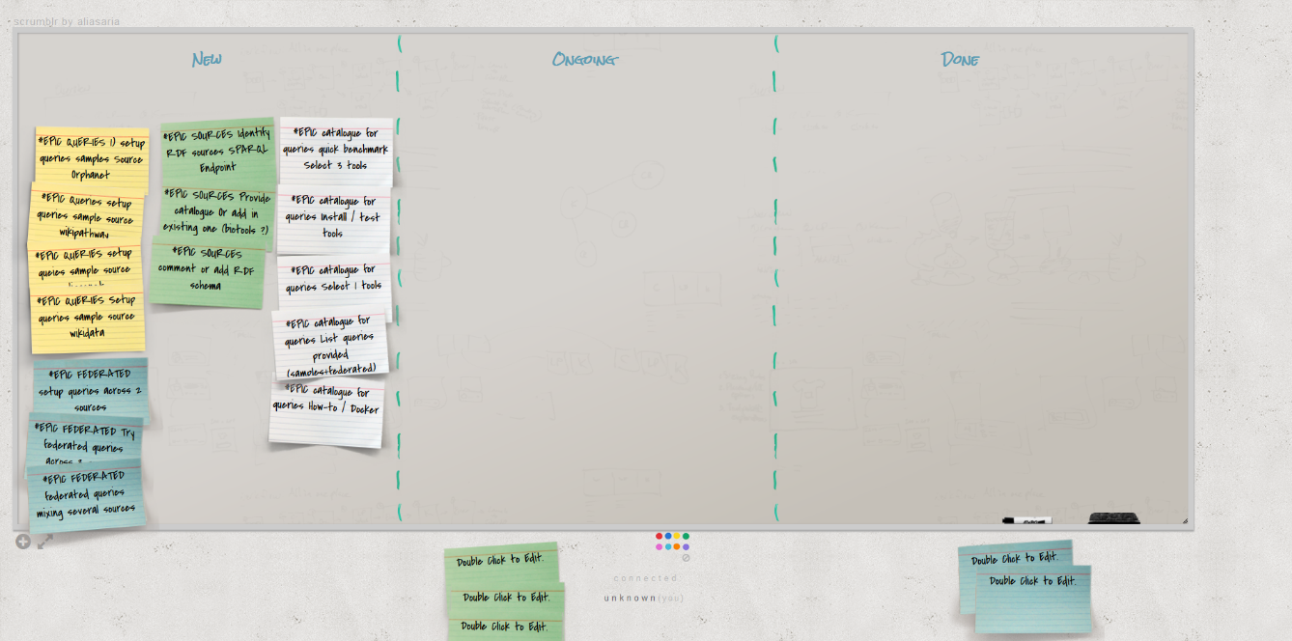
Skills Needed
http://scrumblr.ca/bh2018-orphanet
SPARQL masters, ontologists
Python, Web API, RDF
Docker
Expected hacking days: 4 days
BioHackathon Paris – 12/16 Nov 2018
Notes:
Diapo de Charlotte: frise 20 ans

Slide 9
LINKS
Project representation at the biohackathon
Marc Hanauer, Orphanet INSERM
Invited resource people and associated expertise
Andra Waagmeester, Micelio
You !!
Biohackathon project: https://bit.ly/2P406Jd

